Slide 1
Loan Approval Prediction
Decision Tree Classifier
AI Lab No 3
From: M Haroon Abbas (2K23/BLCS/38)
Course Instructor: Dr Fozia Talpur

Slide 2
Objective
Build an end-to-end ML pipeline for loan approval prediction
Train a Decision Tree model on tabular applicant data
Deploy the model using FastAPI with a web UI
Demonstrate full ML workflow from EDA to production

Slide 3
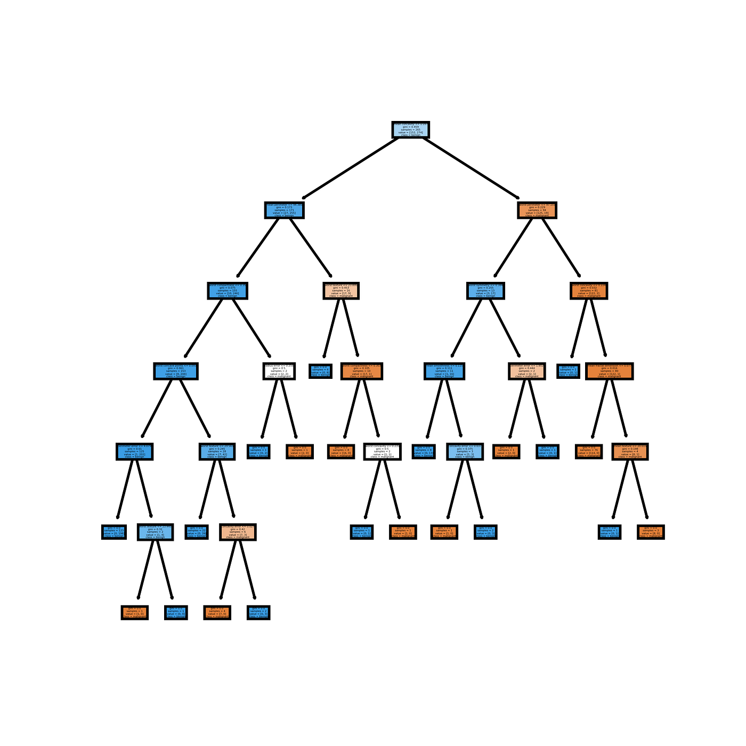
Why Decision Trees
Interpretable: Easy to explain splits and decisions
Handles mixed data: Numeric and categorical features
No scaling needed: Works with raw feature values
Fast training: Efficient for tabular datasets

Slide 4
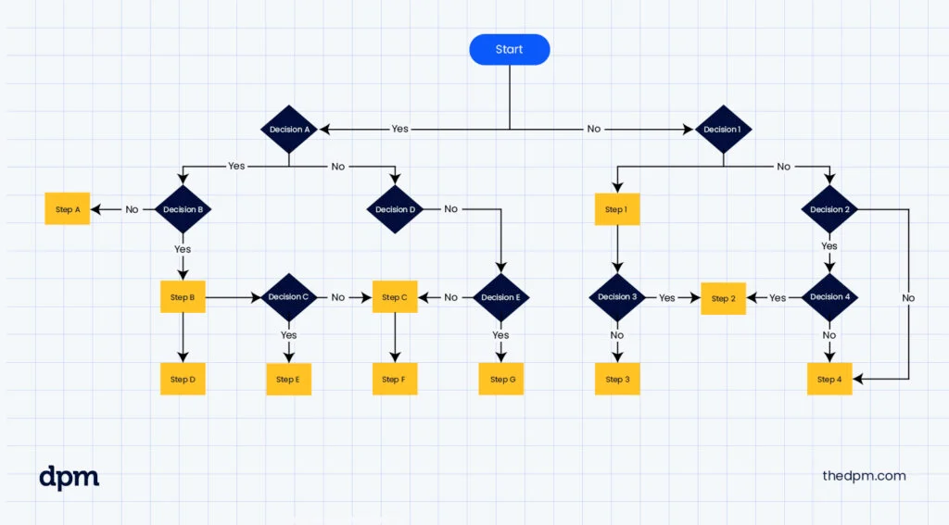
How Decision Trees Work
Trees recursively split data based on feature thresholds to maximize purity.
Select best feature and split point using Gini or Entropy
Create child nodes with purer class distributions
Repeat until stopping criteria met

Slide 5
Pipeline Steps
1. Load Dataset
Kaggle Loan Prediction dataset with applicant features
2. EDA
Analyze missing values, correlations, and class distribution

Slide 6
Pipeline Steps
3. Preprocessing
Impute missing values and one-hot encode categoricals
4. Split Data
60% train, 20% validation, 20% test with stratification

Slide 7
Pipeline Steps
5. Train Model
Tune max_depth, min_samples_split, criterion on validation
6. Save Model
Export pipeline as loan_tree.pkl using joblib

Slide 8
Model Evaluation Results
Accuracy: 83% on test set
Approved class recall: 94% (catches most eligible loans)
Validation AUC: 0.77 (good ranking power)
Weighted F1: 0.82 (balanced performance)

Slide 9
Why These Scores Are Good
High recall means few false rejections of good applicants
83% accuracy is solid for a baseline model
AUC above 0.75 shows effective probability ranking

Slide 10
Key Insights from Output
Final model accuracy ≈ 83% → decent performance
High recall for approved loans (94%) → very few approved loans missed → good for bank
Some false positives for not approved loans (16) → bank may review some extra cases
ROC-AUC = 0.828 → model ranks applicants well for probability of approval

Slide 11
Thank You
Complete ML Pipeline Demo
EDA → Training → Evaluation → Deployment

